Slide 1
Vegetables

Slide 2
Onion

Slide 3
Bell pepper

Slide 4
Tomato

Slide 5
Lettuce

Slide 6
Potato

Slide 7
Carrots

Slide 8
Corn

Slide 9
Chili peppers

Slide 10
Radishes

Slide 11
Cabbage

Slide 12
Egg plant

Slide 13
Cucumber

Slide 14
Spring onion

Slide 15
Cauliflower

Slide 16
Artichoke

Slide 17
Drinks

Slide 18
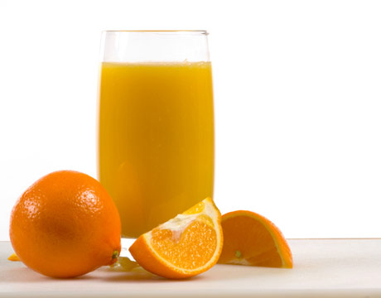
Soda
Juice

Slide 19
Beer
Soft Drink

Slide 20
Dairy

Slide 21


Eggs

Slide 22
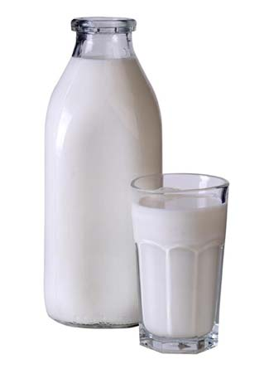
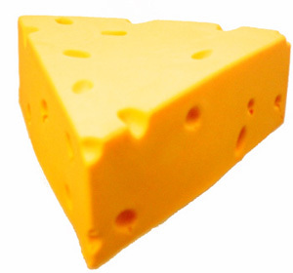
Milk
Cheese

Slide 23
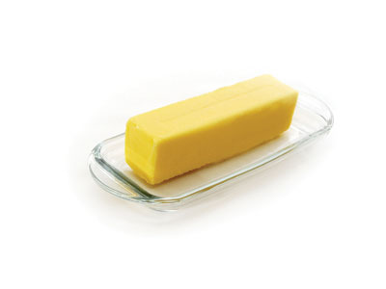
Butter

Slide 24
Meat and poultry

Slide 25
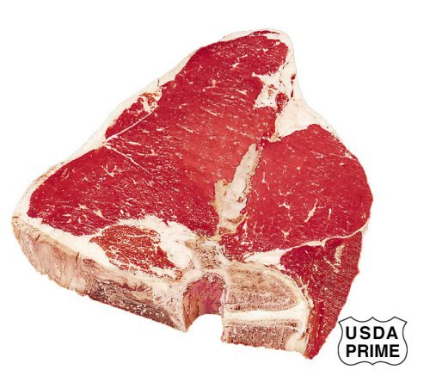
Beef

Slide 26
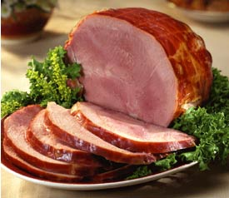

Ham

Slide 27
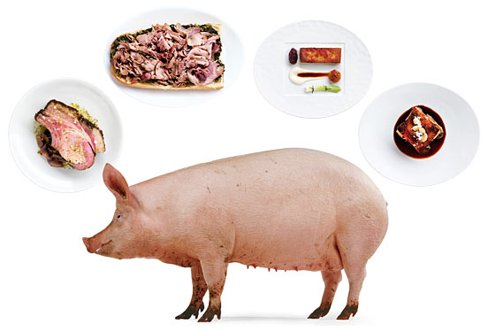
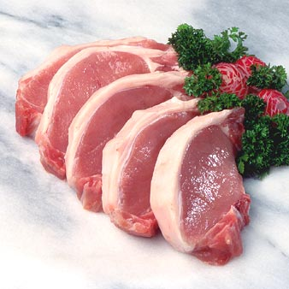
Pork
Pig (Animal)

Slide 28
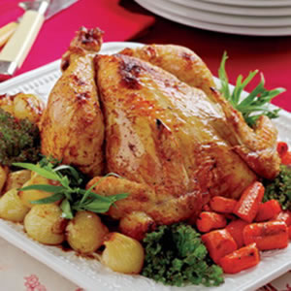
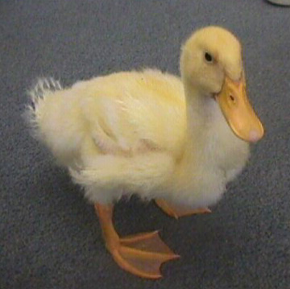
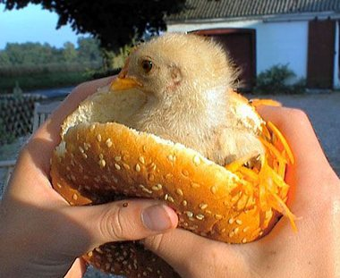
Duck
Chicken

Slide 29
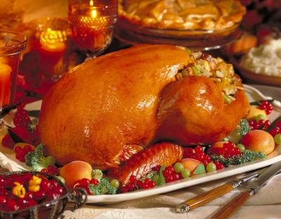
Turkey

Slide 30
Seafood

Slide 31

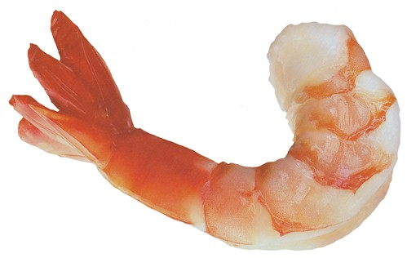
Fish
Shrimp

